Slide 1



Ellie MacDonald
MacComms
Leeds Business Week 2016:
PR for beginners
WIFI code:
GoDo2016!
#LeedsBizWeek
@MacCommsYorks

Slide 2



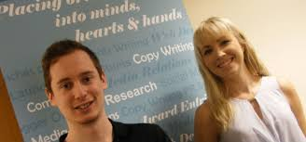

About Ellie MacDonald
Psychology BSc (Hons) degree
Yorkshire Energy Services
Mid Yorkshire Chamber of Commerce
Faith PR
MacComms
#LeedsBizWeek
@MacCommsYorks

Slide 3
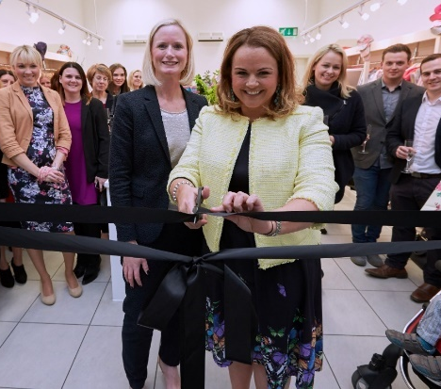
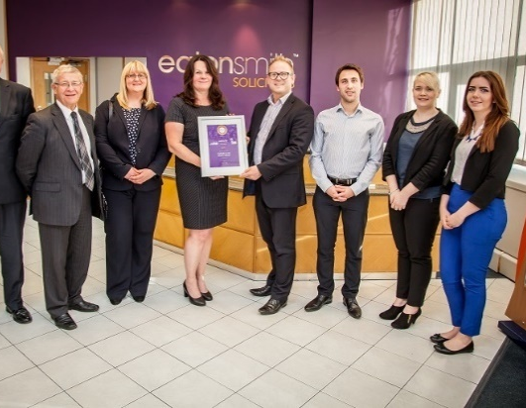
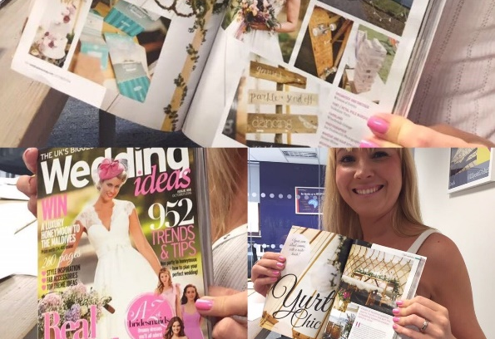
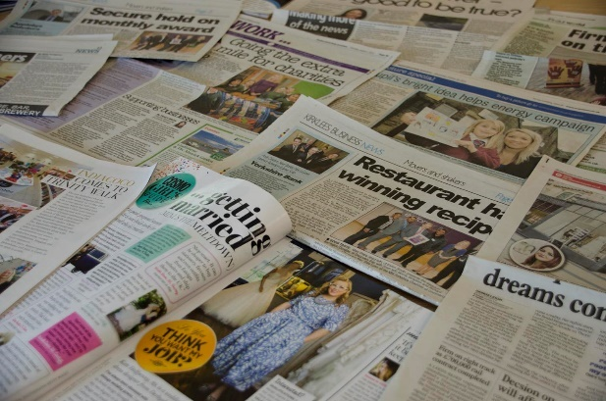
About MacComms
Founded April 2015
PR
Marketing
Social media management
Event management
Wedding specialism
#LeedsBizWeek
@MacCommsYorks

Slide 4

What is PR?
#LeedsBizWeek
@MacCommsYorks

Slide 5
“Public relations is about reputation – the result of what you do, what you say and what others say about you.”
#LeedsBizWeek
@MacCommsYorks

Slide 6

Reputation
Profile
#LeedsBizWeek
@MacCommsYorks

Slide 7
Why raise your profile?
Increase awareness of business, products/services
People buy people
Build credibility
Increase enquiries
Increase sales
=Business growth
#LeedsBizWeek
@MacCommsYorks

Slide 8

5 top practical PR tips…
#LeedsBizWeek
@MacCommsYorks

Slide 9
#1 Get yourself PR-ready
Identify brand values
USPs – become the expert in your sector
Key messages
Target audience (media and Twitter lists)
Marketing:
  Case studies / testimonials
  Website
  Social media
#LeedsBizWeek
@MacCommsYorks

Slide 10
#2 A long-term approach to yield the greatest results
Plan
Research
Execute
Monitor
#LeedsBizWeek
@MacCommsYorks

Slide 11
#3 Develop an editorial calendar
  Research:
    Key awareness dates
    Seasonal trends
    Press release content
    Features
    Profile interviews and opinion pieces
    Awards
  (be location and sector specific)
#LeedsBizWeek
@MacCommsYorks

Slide 12
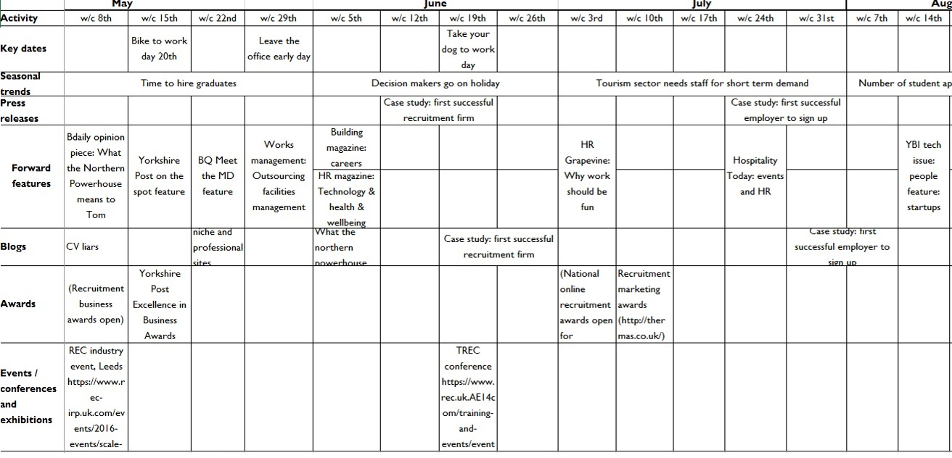
Example editorial calendar
#LeedsBizWeek
@MacCommsYorks

Slide 13
#4 Ensure a joined up approach
Holistic campaigns generate greatest results:
  Press coverage
  Blog posts
  Video
  Social media
  Mail shots
  Events
  Advertising
#LeedsBizWeek
@MacCommsYorks

Slide 14
#5 Monitor
Track coverage: Google Alerts
Google Analytics
Social media management tools (e.g. Hootsuite)
Mail Chimp (open and click through rates)
Award shortlisting and wins
Enquiries
Sales
£££
#LeedsBizWeek
@MacCommsYorks

Slide 15

Final thought
“If I was down to the last dollar of my marketing budget I'd spend it on PR!"
– Bill Gates
#LeedsBizWeek
@MacCommsYorks

Slide 16
Your challenge
Free editorial calendar template when leaving your business card.
Complete it by 11th November 2016
#LeedsBizWeek
@MacCommsYorks

Slide 17
Any questions?
Ellie MacDonald
Managing Director
MacComms
07989 159138
ellie@maccomms.netwww.maccomms.net
#LeedsBizWeek
@MacCommsYorks

